Slide 1
Are Preferences in Public Procurement Fostering or Curbing Corruption?
8th INGP Annual Conference on Public Procurement in the Americas
September 11-13, 2012
Panama City, Panama
Prof. Gustavo Piga
University of Rome Tor Vergata
www.gustavopiga.it

Slide 2
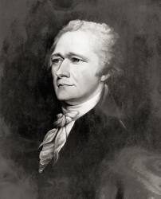
Why prefer (some) firms?
Innovation? Redistribution? Social goals (e.g. unemployment reduction)?
Why not redressing, more generally, an ex-ante asymmetry for which one has no responsibility?
To maintain, between the recent establishments of one country, and the long-matured establishments of another country, a competition upon equal terms, both as to quality and price, is, in most cases, impracticable. The disparity, in the one, or in the other, or in both, must necessarily be so considerable, as to forbid a successful rivalship, without the extraordinary aid and protection of government.
ACROSS COUNTRIES! WHAT ABOUT WITHIN COUNTRY?
MANUFACTURES - Communicated to the House of Representatives, December 5, 1791. ALEXANDER HAMILTON, Secretary of the Treasury.

Slide 3
Why not prefer (some) firms?
“government procurement preferences accorded to Malaysian firms constitute government assistance to these firms. … These preferences not only restrict competition among suppliers, thereby impairing economic efficiency, but also raise the cost to the Government and state-owned enterprises of procuring goods and services. The competitiveness of state-owned enterprises is, in turn, hampered insofar as they are forced by preferential procurement regulations to purchase their inputs from relatively high-cost local suppliers”.
“WTO Trade Policy Review: Malaysia (WT/TPR/S/31, 3 Nov. 1997, para. 122)

Slide 4
What we (try to) do here
So Madison and the WTO would argue for hours about preferences and competition. The former (latter) arguing there is no competition without (with) preferences.
Most of the time, however, possibly through the idea of lack of competitition and higher cost, preferences are associated with the concept of fraud and corruption.
Semantics does not help. “Prefer”, latin: to “bring ahead”.
Here, we do try to establish some connections, especially thinking about SMEs and minority preferences.
Are preferences the outcome of corruption? Or is corruption a reason for introducing preferences?

Slide 5
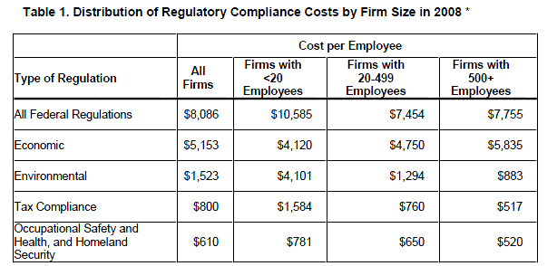
Revisiting Madison’s asymmetry
At the aggregate level, costs per employee appear to be at least 36% higher in small firms than in medium size and large firms.
In particular the same report shows that this disproportion in compliance costs burden especially arises in the manufacturing sector (also if varying across type of regulation).
SBA, Mark Crain (2005)

Slide 6
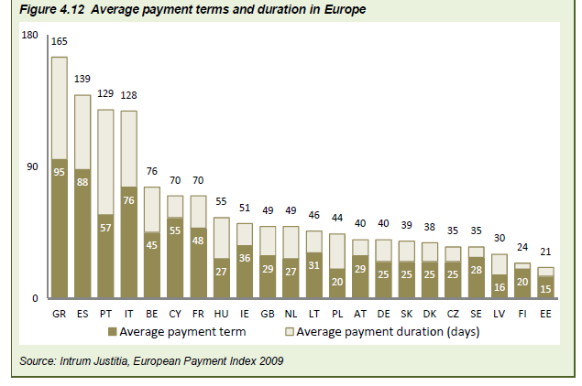
Liquidity Constraints (Recessions)

Slide 7
What About Discrimination?
Why prefer (some) firms?
Negative discrimination due to barriers:
A1) corruption :
a1.1 via networks (easier among large firms/dominant race)
a1.2 via collusion (easier among large firms)
a1.3 via politicians (easier among either closer or larger firms)
A2) risk-aversion:
a2.1 via ignorance (according to UE survey “asking public procurers what current barriers prevent their organization of undertaking additional activities to favor SMEs, most CAs mentioned risk –aversion)
a2.2 via routines (minimum size of revenues etc.)
A3) bias:
a.3.1 via racism
a.3.2 via politics (no connection with size of the firm?)

Slide 8
Barriers exist? Smoking guns
“In terms of estimated total contract value secured, SMEs accounted for between 31% and 38% of public procurement while their overall share in the economy, as calculated on the basis of their combined turnover is 52%”
EC Green Paper

Slide 9
Minority barriers (Bates 2012)
The primary mechanism limiting MBE presence in construction was (and still is) the old-boy network, which frustrated not only minority business access to major construction projects, but acquisition, as well, of skills in select special trades like plumbing and sheet-metal work (Waldinger and Bailey, 1991; Bates and Howell, 1998).
The fact that such exclusion was illegal after 1965 often had little immediate impact on entrenched industry practices. Beneath the laws, regulations, and the union contracts governing industry practices lies a reality of personal contacts and informal networks limiting minority participation. “A high proportion of skilled workers report having fathers or relatives in the trades” (Waldinger and Bailey, 1991, p. 299).
Construction is dominated by small firms hiring and promoting through informal mechanisms. Even skills acquisition did not solve the problem of old-boy networks, where work is parceled out to in-group members, few of whom are minorities.

Slide 10
Barriers are perceived
Problems faced by EU bidders, (by bidders size relative to large firms) The column of totals displays on average which portion of firms interviewed answered “always” or “often”
Potential problems | Micro | Small | Medium | Large | TOTAL %
Over-emphasis on price | 1,1 | 1,0 | 0,9 | 1 | 1,0
Long payment terms | 1,4 | 1,2 | 1,1 | 1 | 1,1
Late payments | 1,3 | 1,0 | 1,1 | 1 | 1,1
No debriefing | 1,2 | 1,0 | 0,9 | 1 | 1,0
Administrative burden | 1,5 | 1,1 | 1,2 | 1 | 1,1
Lack of clarity | 1,4 | 1,0 | 1,0 | 1 | 1,1
Limited options for interaction | 1,4 | 1,0 | 0,9 | 1 | 1,0
Disproportionate financial criteria | 2,0 | 1,2 | 1,1 | 1 | 1,2
Insufficient time to bid | 1,4 | 1,2 | 0,7 | 1 | 1,0
Lack of information on opportunities | 1,4 | 1,3 | 1,1 | 1 | 1,1
Tenders not evaluated fairly | 5,3 | 4,7 | 8,7 | 1 | 6,3
Disproportionate technical criteria | 1,4 | 1,4 | 1,1 | 1 | 1,2
Large contract value | 22,0 | 22,0 | 5,0 | 1 | 7,0
Joint fulfillment of criteria not allowed | 2,0 | 2,0 | 1,5 | 1 | 1,3

Slide 11
But what type of barriers are these?
Factors influencing SMEs share in winning public contracts (UE report – September 2010)
type of procurer: The more the procurer is a central (local) entity, the lower (higher) is the probability for SMEs to win a public contract. TRANSPORTATION COSTS OR CORRUPTION?
contract size (and fewer lots): the higher the contract value, the lesser the likelihood that an SME will win that contract. EFFICIENCY OR CORRUPTION?
MEAT criteria: the use of the MEAT criterion decreases their chance of winning by about 9%: QUALITY OR CORRUPTION?
tender procedure: in terms of the number of contracts won there is no difference within different types of procedures, but in terms of value, SMEs do better in open procedures than negotiated or restricted ones. REPUTATION, RISK-AVERSION OR CORRUPTION?
Notes:
[3] in he report this is simply justified considering that procurers tend to use MEAT for high-value contracts and SMEs have lower chances to win these tenders.
[4] qui entra il paper di ravina su statistical and taste base discrimination.

Slide 12
Barriers and Environment
Barriers Bad Environment | Given for the procurer | Created by the procurer
No | Transportation Costs Learning costs Credit risk Good procurer
Yes

Slide 13
Barriers and Environment
Barriers Bad Environment | Given for the procurer | Created by the procurer
No
Yes | Old Network, Corruption Cartels Credit capture Racism Good procurer

Slide 14
Barriers and Environment
Barriers Bad Environment | Given for the procurer | Created by the procurer
No |  | MEAT Contract Size Incompetent Procurer
Yes

Slide 15
Barriers and Environment
Barriers Bad Environment | Given for the procurer | Created by the procurer
No
Yes |  | MEAT Contract Size Cartels Corrupt procurer

Slide 16
Barriers and Environment
Barriers Bad Environment | Given for the procurer | Created by the procurer
No | Transportation Costs Learning costs Credit risk Good procurer | MEAT Contract Size Incompetence
Yes | Cartels Old Network Credit capture Racism Corruption Good procurer | MEAT Contract Size Cartels Corruption

Slide 17
Given Barriers , Good Environment
Good procurer

Slide 18
Barriers and Environment
Barriers Bad Environment | Given for the procurer | Created by the procurer
No | Transportation Costs Learning costs Credit risk Good procurer
Yes

Slide 19
Classic solutions
- skills assessment and development programs
- business mentoring or coaching
- training in commercial tendering
- small business advice
- simplification of bidding documents and questionnaires
- translation of documents into local language
- lowering or rationalization of pre-qualification criteria
- reduction in costs of bidding, e.g. payment for bidding documents
- lowering of barriers to entry, e.g. compulsory industry registrations
- access to additional or cheaper forms of business financing and investment
- more transparent publication of business opportunities
- communication programs

Slide 20
Unorthodox solutions: preferences
“Failing to recognize how affirmative action can be used to enhance procurement competition grossly overstates the cost of affirmative action subsidies.”
For example, nonpartisan state legislative analysts estimate the California Department of General Services spent an additional $9.9 million last year by rejecting low bids from firms that failed to comply with affirmative action requirements. Unfortunately, these estimates ignore how affirmative action may have driven down the low bids that were used as the benchmark. Without the enhanced bidding competition created by affirmative action, these low bids and the low bids on other bidding contracts may have been substantially higher.”

Slide 21
The Empirical Economic Literature
Both set aside and bid preference scheme end up with:
Increase in SMEs’ participation and decrease in large firms participation.
J. NAKABAYASHI (2009), looking at the impact of SME’s set-aside program from Japanese public procurement auction for civil engineering works (2/3 of the procurement budget was set aside for SME), shows that this kind of program increases SMEs’ participation (by a counterfactual simulation, the non existence of set aside reduces SMEs’ participation by approximately 40%). Krasnokutsawa and Seim (2010) and Marion (2006) found the same participation effects (with different intensity) through empirical analysis on Californian Highway Procurement Auctions.
Changes in the degree of competition : Large firms bid more aggressively while SMEs are likely to soften bid aggressiveness.
Marion (2006), using Californian data on bid preference (5%) scheme accorded for construction contracts financed at the state level, shows that bid aggressiveness is positively related with firm’s size in the case of preference auction targeted at small firms.
Hubbard - Paarsch (2009) using a numerical simulation confirm the participation effect and competitive effect found by Marion.

Slide 22
Given Barriers,
Bad
Environment
Good procurer

Slide 23
Barriers and Environment
Barriers Bad Environment | Given for the procurer | Created by the procurer
No
Yes | Old Network Cartels Credit capture Racism Corruption Good procurer

Slide 24
Statement # 4
Fighting Cartels can be one of the Best Tools to Fight Corruption
since Corruption and Collusion are strategic complements.
Furthermore cartels tend to exclude small firms.

Slide 25
Unorthodox solutions: set asides
“For example, if four incumbent construction firms were bidding to build four different playgrounds, they might be able to coordinate their bidding (either tacitly or explicitly) to divide the contracts among themselves.”
“Setting aside one of the bidding contracts for traditionally disadvantaged, non-incumbent firms may enhance intragroup competition, as the four incumbents must now compete for just three contracts. Any incumbent that believes it may end up empty-handed is likely to reduce the markup in its sealed bid. While the government may pay more on contracts set aside for traditionally disadvantaged bidders, reduced costs for non-set-aside contracts can lower overall procurement costs.”

Slide 26
Other Impacts of Preferences
Insofar as the lack of competitiveness of small firms with respect to large firms is due to discrimination in credit markets (including as a consequence of delays of payment by governments), inefficiencies from subsidies are reduced.
Dynamic competition may make these inefficiencies vanish over time as subsidies today - that encourage small firms to sustain fixed costs and try to enter the public market by participating to tenders - increase the likelihood of unsubsidized entry tomorrow by stronger to be candidates (SME’s that have become large/successful firms) and more competition makes cartels and corruption harder.
“The immediate difficulty … was the mismatch between the needs of government for specific goods and services and the industry distribution and limited capacity of most MBEs. Most were in the wrong lines of business and lacked, as well, the necessary expertise, working capital, and bonding capacity contractors needed to complete successfully all but the smallest government procurement tasks”. (Bates). Dynamic learning.

Slide 27
Procurement Creates Barriers,
Good Environment
Incompetence

Slide 28
Barriers and Environment
Barriers Bad Environment | Given for the procurer | Created by the procurer
No |  | MEAT Contract Size Incompetent Procurer
Yes

Slide 29
Supervision. The SBA Procurement Center Representative (Pcr)
These are representatives of the U.S. Small Business Administration in the various large Procurement Agencies.
Functions and Powers:
1. Analyze the procurement strategies and verify if contract-bundling is necessary and justified
2. Propose alternative solutions to the contracting officer to foster SMEs partecipation
3. In case of a failed agreement, escalate the issue in the hands of the Agency Manager.

Slide 30
But risk of incompetence …
“SME preferences tend to proliferate over time and if, once in place, they are immutable”. An empirical question.
No SBA study that verifies whether SMEs helped by the SBA policies on procurement have actually grown, closed or simply stayed put, and this lack of research is quite astonishing as it reduces the accountability of the work of the SBA.
South African example seems to underscore the fact that preferences schemes can change and possibly be improved over time, (if competence is there).

Slide 31
Procurement Creates Barriers,
Bad Environment
Corruption

Slide 32
Barriers and Environment
Barriers Bad Environment | Given for the procurer | Created by the procurer
No
Yes |  | MEAT Contract Size Cartels Corrupt procurer

Slide 33
But risk of set-asides gets huge …
Fraud. “fake” (small) corporations might be created only for the purpose of being awarded the procurement contract at a higher price. Or else, large companies might redefine their structure to participate as small ones and obtain the advantage (Brazil). A corrupt environment might make this fraud easier.
Preferences in the hands of dominant lobby.
And solution to discrimination and barriers goes through “political representation” and growth of sensitivity to discriminated lobbies (see Bates for Afro-American discourse in the 1970s), rather than through institutions.

Slide 34
Barriers and Environment
Barriers Bad Environment | Given for the procurer | Created by the procurer
No | SIMPLIFICATION PREFERENCES | SIMPLIFICATION SET-ASIDES, PREFERENCES, CENTRAL MONITORING
Yes | SIMPLIFICATION SET ASIDES AND PREFERENCES | SIMPLIFICATION POLITICAL EMPOWERMENT FIRST

Slide 35
Conclusions (tentative)
Set-aside and preferences might be optimal with competences, professionalization and integrity.
Set-asides and preferences are risky with incompetence and disastrous with systemic corruption.

